Slide 1
2017
Something about
source code
summarization
杨绍雄

Slide 2
outline
01
02
03
Previous work
最新的Convolutional Attention Network 模型
我的想法

Slide 3
01
Previous Work

Slide 4
Previous work
从不同的角度分类
研究一个好的Summary需要的特点，为后续工作提供guidelines.
1
1
针对methods或者classes从代码内部出发研究其summary，研究重点在于key identifies和call information.
2
3
2
从代码外部出发，通过收集类似于知识库的形式对代码进行摘要
3
Notes:
之前的研究小会是按时间点讲的

Slide 5
提供guidelines
NLDB2010-Automatic quality assessment of source code comments
Present an effective and automated approach for assessing the quality of
inline documentation using a set of heuristics, targeting both quality of
language and consistency between source code and its comments.
2012-Automated Feature Discovery via Sentence Selection and Source
Code Summarization
通过大量不同方法的实验对比明确指出句子选择策略摘要的不足。
结论：句子选择策略不足以完成较好的摘要（LDAmodel抽取主题有较好
的效果）；文本分析方法着重于结构和顺序，而程序，尤其是method
通常是无序的，因此研究methods之间的交互是一个非常重要的点
（high-level information）。
Notes:
上——着重于一致性和语言的质量
下——

Slide 6
提供guidelines
icse2014-Improving Automated Source Code Summarization via an
Eye-Tracking Study of Programmers
2014-Selection and Presentation Practices for Code Example
Summarization
2014 An empirical study of the textual similarity between source code
and source code summaries
指出自动生成的摘要更像读者角度，从原有的代码出发，没有解决读者
和作者之间理解角度偏差的问题。
通过比较作者的摘要和读者的摘要来得到对自动摘要生成工具的
guidelines。
Notes:
上中——eye-tracking 了解人们在读代码时候的习惯，说明了代码的哪些部分是最重要的，哪些次要
下——

Slide 7
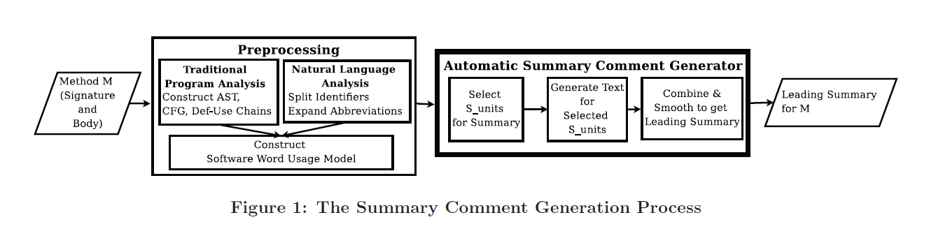
从代码内部出发
ASE2010 Towards automatically generating summary comments for
JAVA methods
Notes:
比较传统的方法，先做预处理，再选择最重要的句子或代码段，最后生成语言

Slide 8
从代码内部出发
WCRE2010-On the Use of Automated Text Summarization Techniques for
Summarizing Source Code
Study a solution to illustrate the software entities without having to read
the details of the implementation.
Two main challenges: determining what should be included and how to
generate them automatically.
Notes:
也是传统方法，着重于应该选择什么信息以及自然语言的生成

Slide 9
从代码内部出发
ICPC2013 automatic generation of natural language summaries for
JAVA classes
研究点：content and responsibilities rather than their relationships
with other classes
原因：methods上的方法不能直接套用
重点：the type of methods and their distribution in a class
Notes:
着重点：class

Slide 10
从代码内部出发
ICPC2014-Automatic documentation generation via source code
summarization of method context
In this paper, we propose a technique that includes this context by
analyzing how the Java methods are invoked. In a user study,
we found that programmers benefit from our generated documentation
because it includes context information.
Notes:
着重点：methods call

Slide 11
从代码内部出发
ICSE2015-Automatic Documentation Generation via Source Code Summarization
what makes a "good" source code comment
RQ1 How similar should the text in summaries be to text and keywords in the source code?
RQ2 To what degree should contextual information about code be included in summaries of that code?
RQ3 To what extent can the file structure of source code affect the quality of documentation?
Notes:
相似性、上下文信息、结构信息？

Slide 12
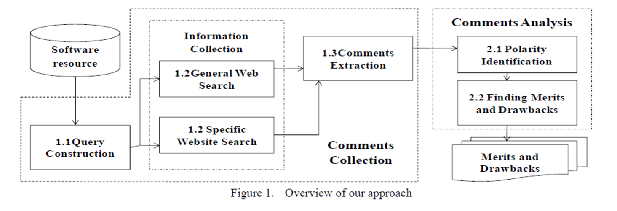
从代码外部出发
ASE2011 Finding the merits and drawbacks of software resource from
Comments
整体如下，通过在网络上搜寻有关代码的评论，分析其极性来得到其
优缺点。

Slide 13
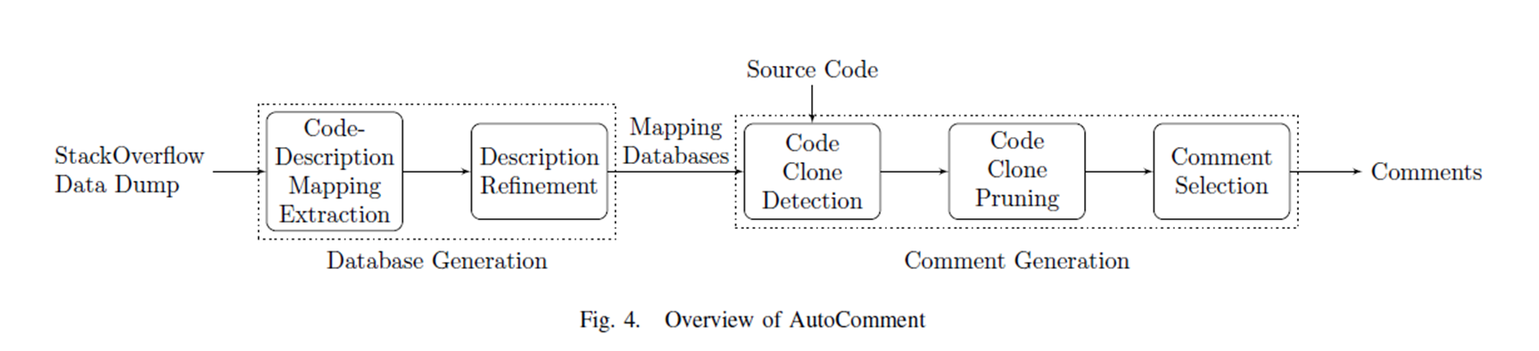
从代码外部出发
ASE2013 AutoComment: Mining Question and Answer Sites for
Automatic Comment Generation

Slide 14
从代码外部出发
ICSE2015-Leveraging Informal Documentation to Summarize Classes and
Methods in Context
1. StackOverflow + Identifiers
2. We use the context that surrounds code elements in StackOverflow
posts to summarize the use and purpose of code elements.
3. To provide focus to our investigation, we consider the generation of
summaries for library identifiers discussed in StackOverflow.

Slide 15
02
神经网络模型

Slide 16
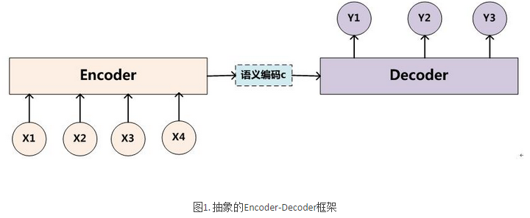



2016 A Convolutional Attention Network for Extreme Summarization of Source Code
用带attention机制的卷积神经网络来做方法名预测（method为主）
Encoder-Decoder框架
Notes:
ED模型是现在比较常用的模型，可以完成从序列到序列的转化 现多用于机器翻译，比如英译中。
举例： I love China

Slide 17
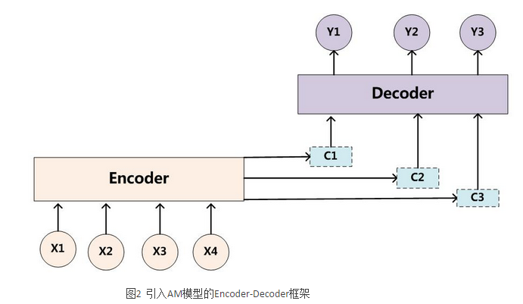

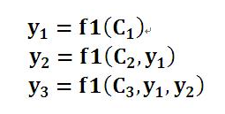
引入Attention

Slide 18
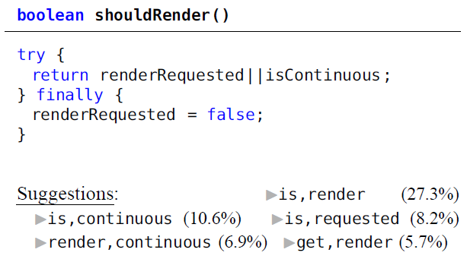


Slide 19
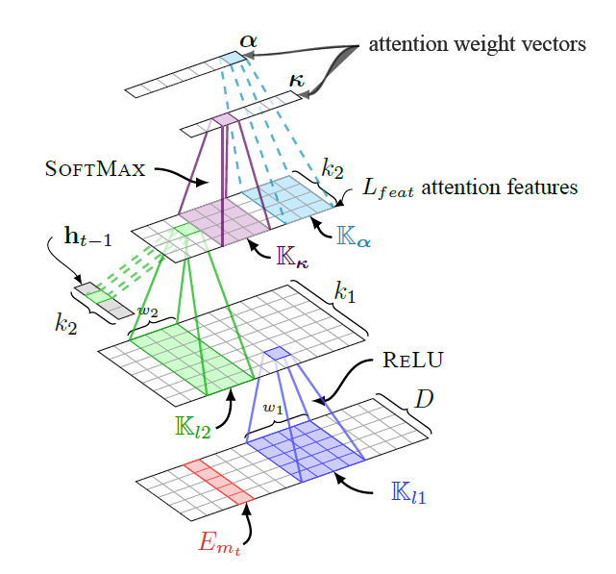
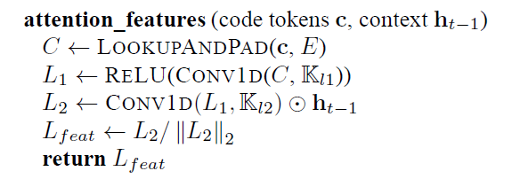

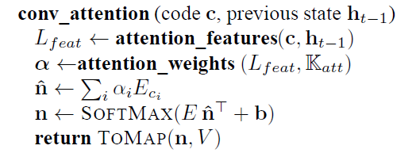
Notes:
t时刻，前t-1个词已经生成。 E：词典。通过两个卷积层和之前的隐藏层的状态生成本次的attention，分类到输入向量中，映射回词典。

Slide 20
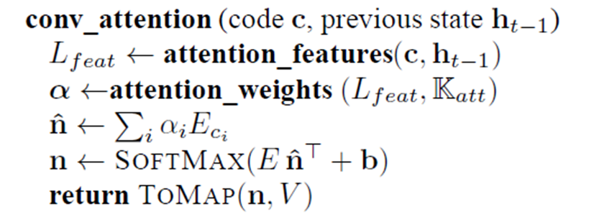
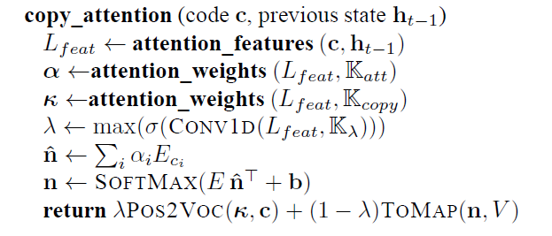
OOV?

Slide 21
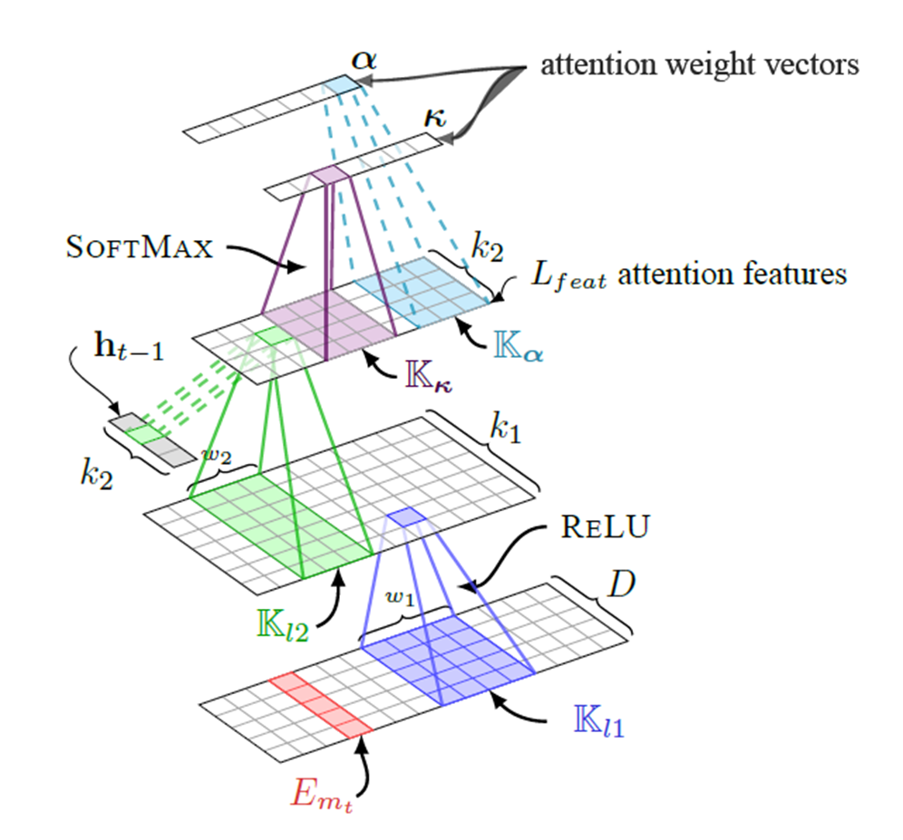
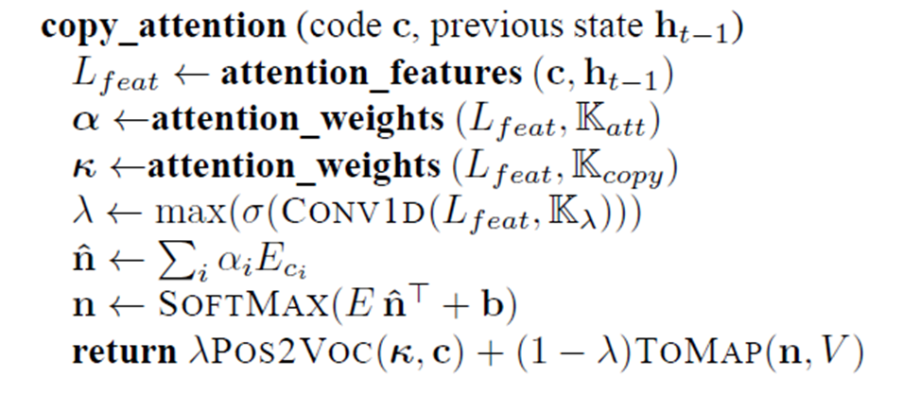
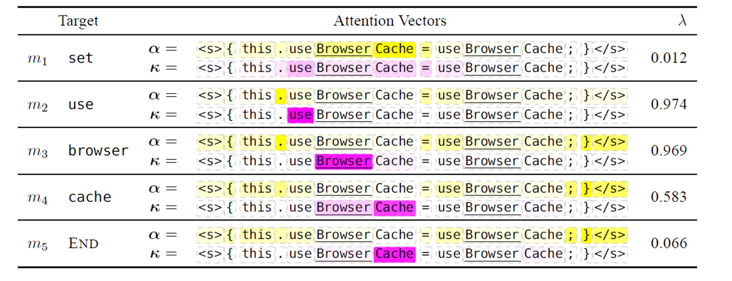
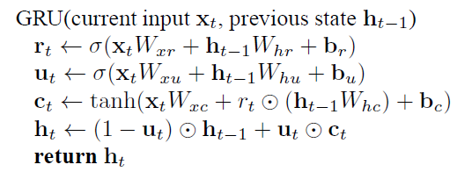


Slide 22
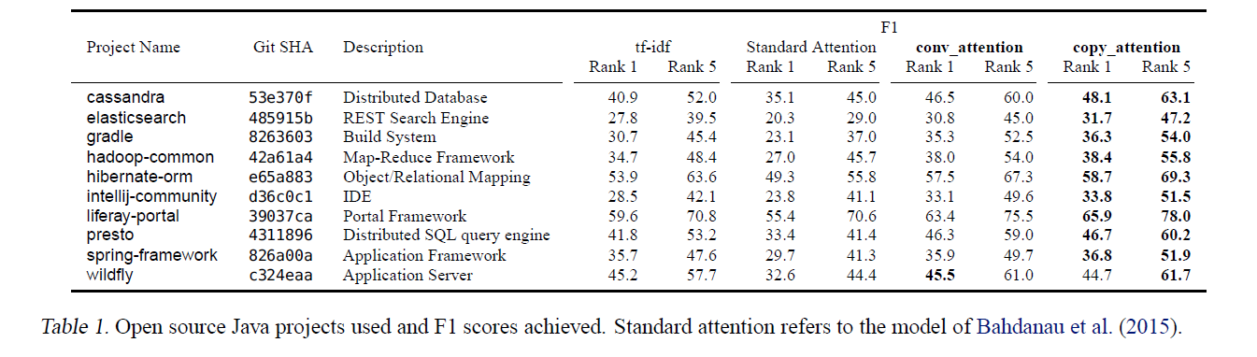
Evaluation
Dataset collection
Experimental setup
Training
Notes:
11 open source JAVA projects from GitHub. 10MB data each expe…: tf-idf biRNN :Although source code snippets resemble natural language sentences, they are more structured, much longer and vary greatly in length.
One hypothesis is that the biRNN of the standard attention model fails to capture long-range features, especially in very long inputs. SHUFFLE!

Slide 23
03
思路

Slide 24
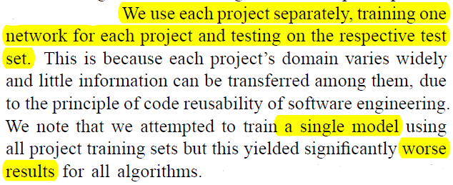
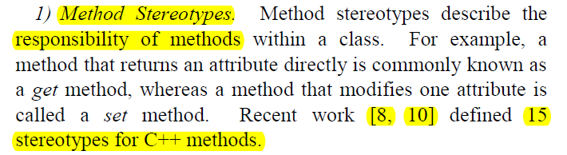
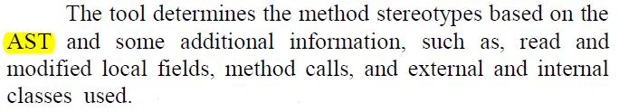
ICPC2013 automatic generation of natural language summaries for JAVA classes
Notes:
无形中按作者分，会有一定的效果，但是泛用性不高。按代码结构分？
More structured, much longer. 半监督的方法，根据之前的分类工作，标注一部分数据，对大数据进行分类，按类别进行训练，或者将类别作为输入的一个特征。
除此之外，将在输入向量中加入可以训练结构的特征，比如在后面加上标志位。

